Slide 1














Trivia - PhotoGraphy Website

Slide 2
Contents
Introduction
Objectives
Scope
Literature Survey
Proposed System
Project Outcomes
Block Diagram
Use Case/DFD
Technology Stack
Suggestions in Review-1
Result and Discussion
Conclusion and Future Scope
References

Slide 3

Trivia is a photography website that connects people with beautiful photos of their choice , feeling and emotions.
Trivia photography website goal is to “connect everyone in the world through the thing they find interesting”
Trivia is a social media has, without a doubt, for sharing and categorizing images found online, changed the way consumers interact with brands and businesses.
Users can browse or search for image.

Slide 4

To create user friendly interface for our website.
To develop a system to enable the user to share photos easily.
To Incorporate Trivia into a marketing campaign.
To develop a Simple and Reactive website.
To enable classifiers.

Slide 5

User will be able to sign in and login.
User can search images from all over the world.
Pictures can be used to set as wallpaper and store the pictures.
User can upload their own collection of photos.
User will be able to classify images.
User will be able to filter through images.

Slide 6

Image classification is a method to classify way images into their respective category classes.Image classification refers to the task of extracting information classes from a raster image. The resulting raster from image classification can be used to create thematic maps.The classification process is a multi-step workflow, therefore, the Image Classification toolbar has been developed to provided an integrated environment to perform classifications with thetools.
Art Photo Index (API) is a visual index of important art and documentary photographers, their images and their websites from throughout the world. The photographers included in Art PhotoIndex have been selected as a result of their accomplishments in the art or documentary photography field. Find photo essays, slideshows, and featured galleries of images. Includes journalism photography and user-generated content..

Slide 7

Proposed System
Login system.
User will be able to login or create his own account.
Upload images.
User can upload images.
Search Images
User can search any image of his need.

Slide 8

User can log in website with their own credentials
User can search there image as per there requirement.
User can upload images.
User can filter through images.
User can classify images,

Slide 9

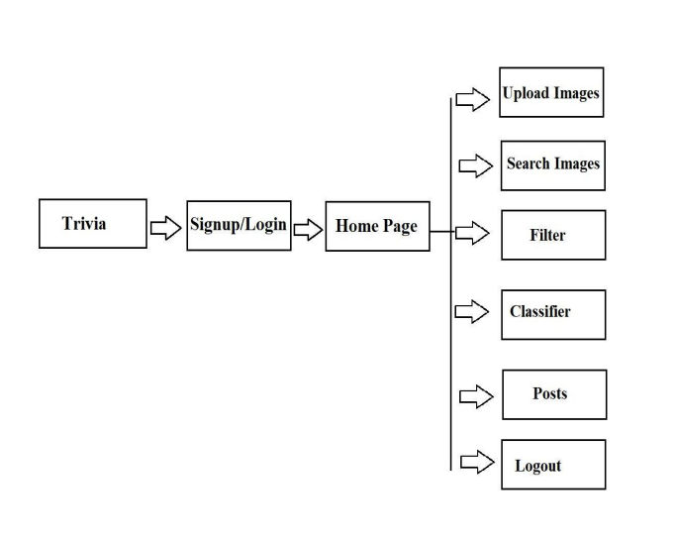

Slide 10

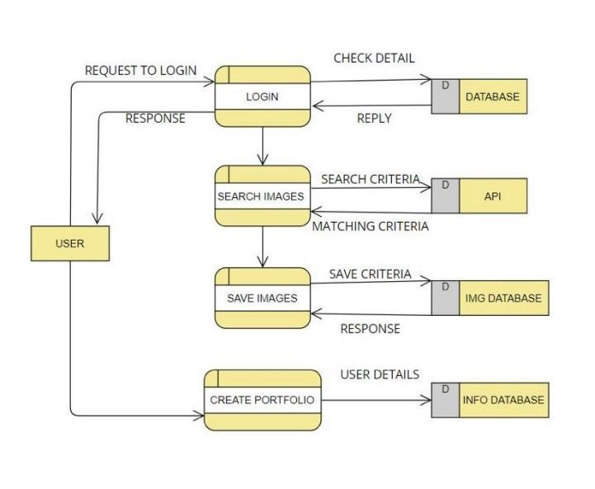
upload imgs

Slide 11

FrontEnd - HTML & CSS
Database - FireBase
BackEnd - Node JS
Idle: vs code
Operating system : Window 11

Slide 12
Suggestions in Review-1
▶ To Add Filters.
▶ To Add More Functions.
▶ To Make Website more reactive.
▶ To Add user Portfolio.
▶ To enhance website by adding photos , fonts and colors.

Slide 13
Result and Discussion
▶ Trivia is ideal for telling stories through images, thanks to the famous infographics published by many of its users on their respective boards.
▶ Trivia is an image sharing and social media service designed to enable saving and discovery of information on the internet using images.

Slide 14
Conclusion and Future Scope
▶ Trivia is a photography website where user can create his/her account and upload photos.
▶ User can aslo download photos.
▶ In future, we could add the uploading and downloading videos feature.
▶ Communication with other users.
▶ Adding any photo to your wishlist.
▶ To Add notification feature.

Slide 15
References
▶ https://www.bartleby.com/essay/Research-Paper- On-Pinterest-FJ6QGG44EEV
▶ https://in.pinterest.com/
▶ https://www.youtube.com/watch?v=wfgGyQ_FDik
▶ https://en.wikipedia.org/wiki/Pinterest
▶ https://www.youtube.com/watch?v=k_WlkZ39rak

Slide 16
Thank You...!!

